Slide 1
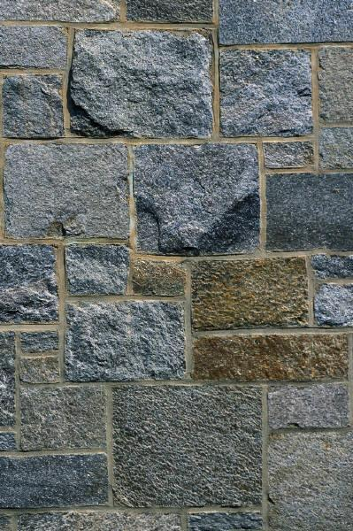
The Relative Age of Rocks
Objectives:
Explain the law of superposition
Explain how geologists determine the relative age of rocks
Evaluate the usefulness of index fossils.

Slide 2
Geologic Time Scale
The Geologic Time Scale is a record of the life forms and geologic events in Earth’s history.
Why do we not talk in terms of calendars when we talk about the Earth’s geologic history?
Notes:
TPS

Slide 3
Relative vs. Absolute age
What is the difference between these two statements:
I am older than my sister.
I am 42 years old.
Geologists use both of these ways to express the age of a rock and any fossil found in it.

Slide 4
Relative age: The age of a rock compared to the ages of other rocks.
Absolute age: The number of years since a rock was formed.
Everyone and everything can be given a relative and absolute age.
Notes:
Solicit examples from the students.

Slide 5
The Position of Rock Layers
Scientists have a hard time determining the absolute age of rocks. Why do you think that is so?
Recall the “Law of superposition”.
The law of superposition states that in horizontal sedimentary rock layers _______.
How can the law of superposition help us determine the relative age of a sedimentary rock layer?
Notes:
TPS

Slide 6
Law of superposition - activity
Spread the cards on the table.
Assuming that CT is the oldest layer, position the cards from oldest to youngest.
Be ready to explain your reasoning.
Notes:
Fossil inferences lesson: http://www.uen.org/Lessonplan/preview.cgi?LPid=16319

Slide 7
Determining Relative Age
There are other clues besides the position of rock layers.
Cross-Cutting Principle: When something cuts across a body of rock, that “something” is younger than the rock it cuts across.

Slide 8
Determining Relative Age
Clues from igneous rocks:
Lava that hardens on the surface is called an extrusion. An extrusion is always younger than the rocks below it.
Lava that cools and hardens below the surface is called an intrusion. An intrusion is always younger than the rock layers that surround it.
WHY?
Notes:
TPS

Slide 10
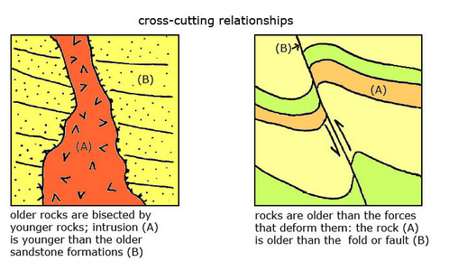
Clues from faults: A fault is always younger than the rock it cuts through

Slide 11
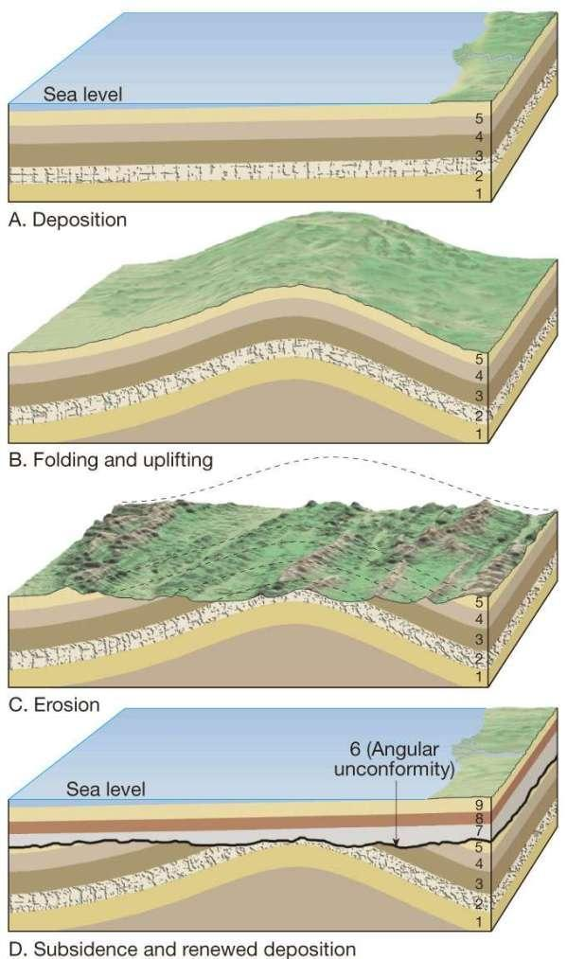
What happens when parts of a layer have eroded away or been otherwise lost?
Uncomformity: When new rock layers are much younger than the layers beneath it.

Slide 12
Using Fossils to Date Rocks
To date rock layers, geologists first give a relative age to a layer of rock at one location. Then they can give the same age to matching layers of rock at other locations.

Slide 13
Example using Silly Bandz
Points of agreement:
Silly Bandz were popular between July-Oct 2010.
Silly Bandz could be bought anywhere during that time.
By Dec 2010, it had become very difficult to get Silly Bandz.
Using most people’s standards, by December 2010 it had become “silly” to wear Silly Bandz.

Slide 14
Now let’s assume that I open my daughter’s dresser today and find a pile of Silly Bandz. When can I assume that she put them there? *
Let’s travel 3 years into the future. My daughter is finally cleaning out her dresser. She finds a couple of Silly Bandz sandwiched between a purple shirt (bottom) and a blue shirt (top).
What is the relative age of the purple shirt? How do you know? *
Finally, lets imagine that Hannah finds an undated letter from Annie with a brand new packet of Silly Bandz. Can she accurately estimate its date? Why or why not. *
Notes:
* TPS

Slide 15
Back to geology, index fossils (Silly Bandz) help geologists match rock layers, and helping to determine the relative ages of the rocks in which they occur.
To be useful as an index fossil, a fossil must be widely distributed and represent a type of organism that existed only briefly. Why?*
Notes:
* TPS

Slide 16
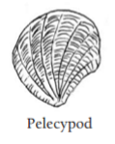
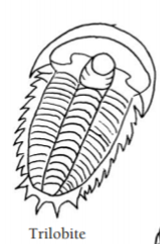
Use the following information to arrange the fossil cards in order.
Pelecypods appeared 500 million years ago.
Trilobites disappeared 250 million years ago.

